Slide 1
Database Fundamentals & Design
Presented by
Josephine Boles

Slide 2
Outline
Data & Information.
File Based System.
What is Database, Database System?
DBMS & its functions.
Database Properties.
Advantages and Disadvantages of Database Systems.
DB Architecture.
Distributed Processing & Architectural Design.
Who Deals with Database.
Data Models.

Slide 3

Course Objectives
fundamentals of Databases. Trainees will develop skills in the design, construction, modification, and use of databases.Structured Query Language (SQL) will be emphasized.

Slide 4
Grading System
Course Duration
Lectures : 18 hrs.
Labs : 12 hrs.
Assignments and Lab Work 40%
Final Exam 60%

Slide 5
Data & Information
Data is the raw input (numbers, characters, images…) which when processed or arranged makes meaningful output (Information)
Data is the lowest level of knowledge and information is the second level.
Data by itself alone is not significant. Information is significant by itself.
Observations and recordings are done to obtain data, while analysis and processing are done to obtain information.

Slide 6

Database interact with

Slide 7

Database interact with

Slide 8
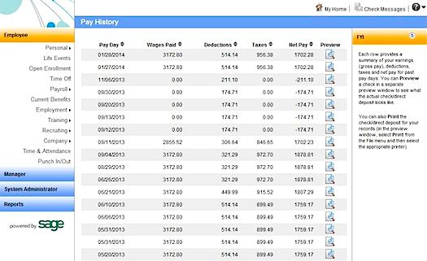
Database interact with

Slide 9
File Based System
It is a collection of programs that perform services for the end user.
Each Program defines and manages its own data.

Slide 10
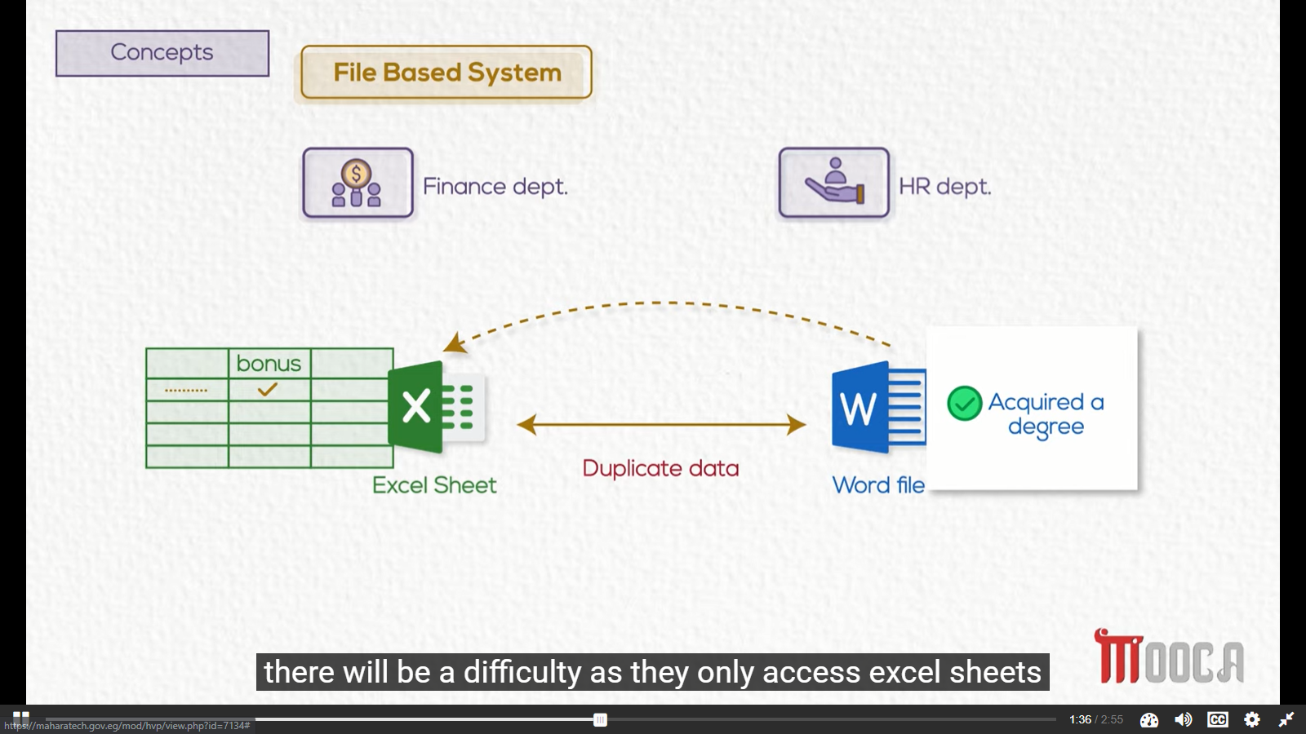

Slide 11
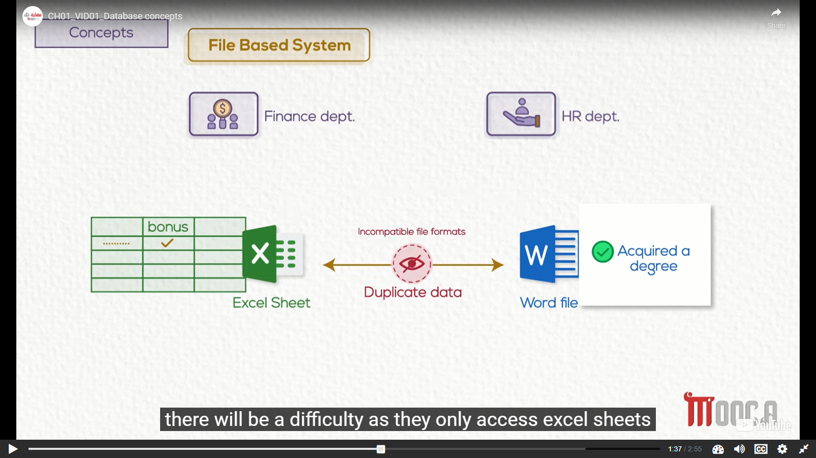

Slide 12
Limitations
Separation & Isolation Of data
Duplication Of data
Program Data Dependence
Incompatible File Formats

Slide 13
What is a database?
“A database is an organized collection of related data”
The data is typically organized to model relevant aspects of reality in a way that supports processes requiring this information

Slide 14
Database System
The database
The Software
Application Program
DBMS

Slide 15


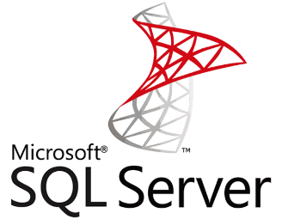
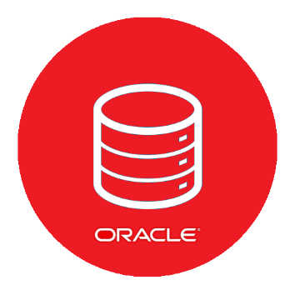
Database Management System (DBMS)
It is the intermediate layer between the database and the programs that access the data.
It is collection of programs that enables users to create and maintain a database.

Slide 16
DBMS Functions
Defining Database.
Constructing Database.
Manipulating Database.
Data Independence.
Data Security & Integrity.
Concurrency.
Backup & Recovery.
Data Dictionary (Meta Data).
Performance.

Slide 17
DBMS Advantages
Controlling Redundancy.
Restricting Unauthorized Access.
Sharing data.
Enforcing Integrity Constraints
Inconsistency can be avoided.
Providing Backup and Recovery.

Slide 18
DBMS Disadvantages
Needs expertise to use (which is expensive)
DBMS is expensive
DBMS may be incompatible with any other available DBMS

Slide 19
Database Management System (DBMS)
Users
Database System
Application Programs
DBMS Software
Software to process
Queries
Software to access Stored Data
Stored DB
Definition
(Metadata)
Stored
Database
Notes:
DBMS is a collection of programs that enables users to create and maintain a database. The DBMS is a software system that facilitates the process of defining, constructing, and manipulating databases for various applications. Defining a database involves specifying the data types, and constraints for the data to be stored in the database. Constructing the database is the process of storing the data itself on some storage medium. Manipulating a database includes such functions as querying the database to retrieve, update, delete specific data.
What are the other functions of DBMS ?
Data Security & Integrity , Concurrency , Recovery, Performance , Data Dictionary

Slide 20
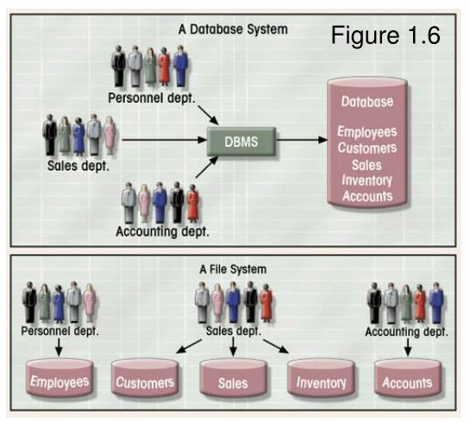
Database vs. File System

Slide 21
Database Properties
Self describing nature.
Insulation between program and data.
Sharing of data and multi user transaction processing.

Slide 22
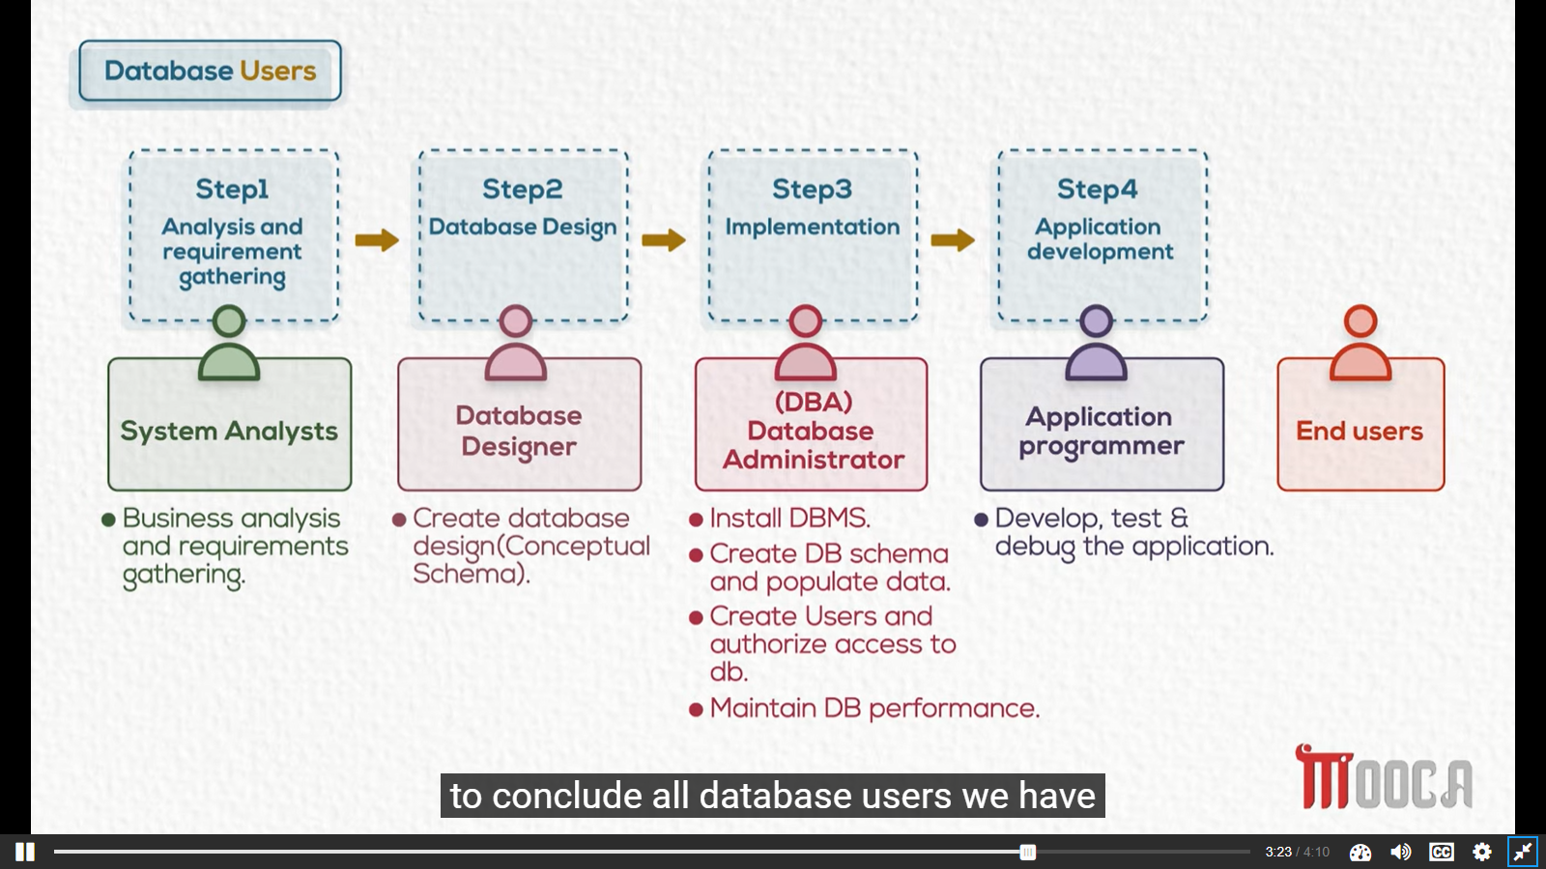
Database Users

Slide 23
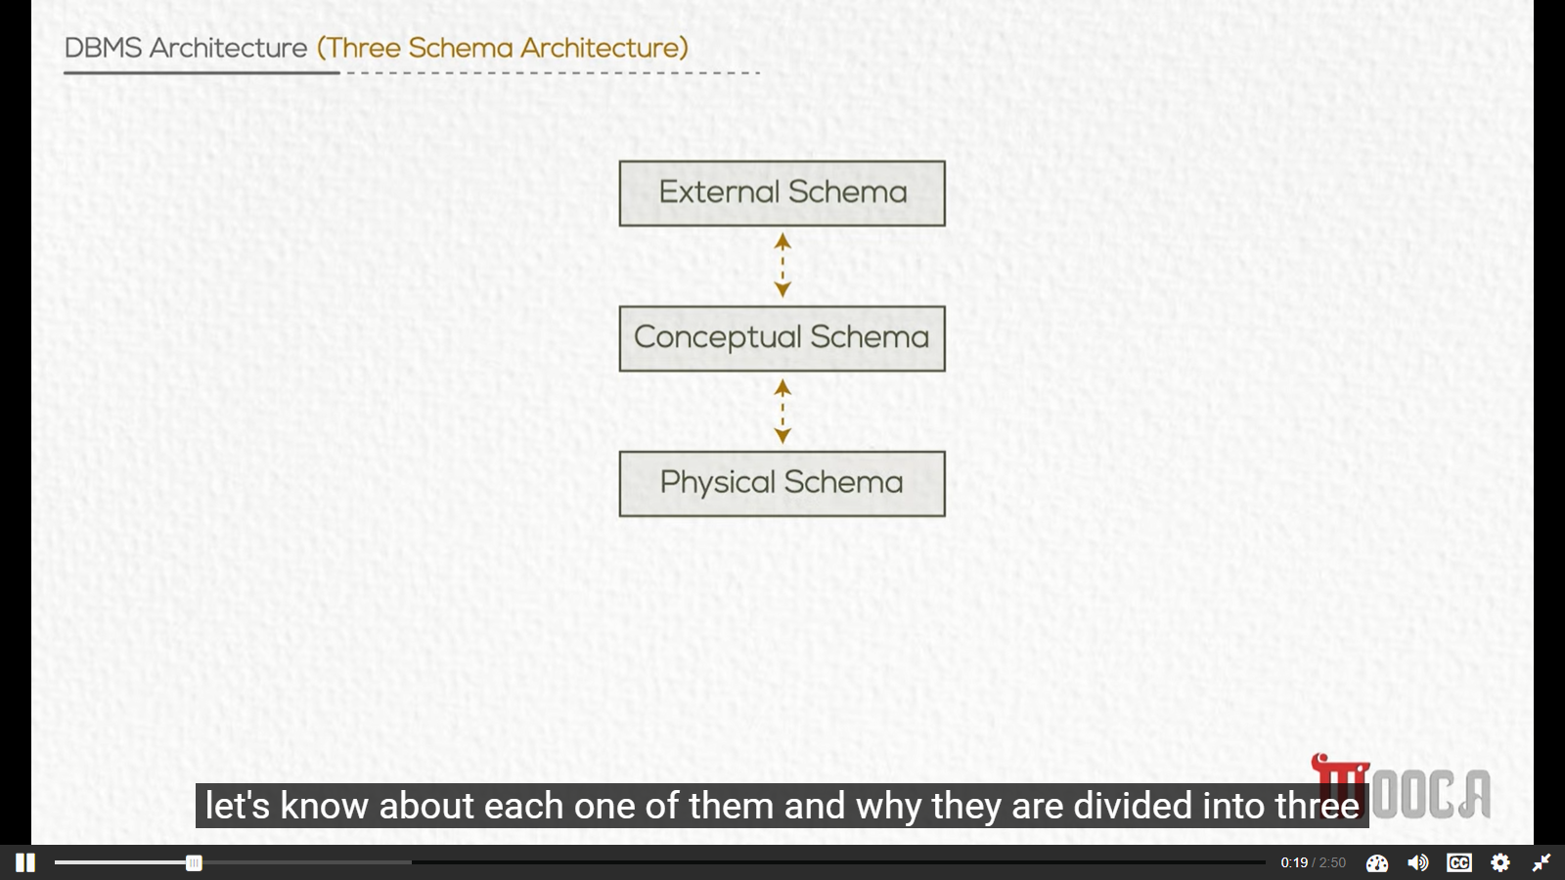

Slide 24
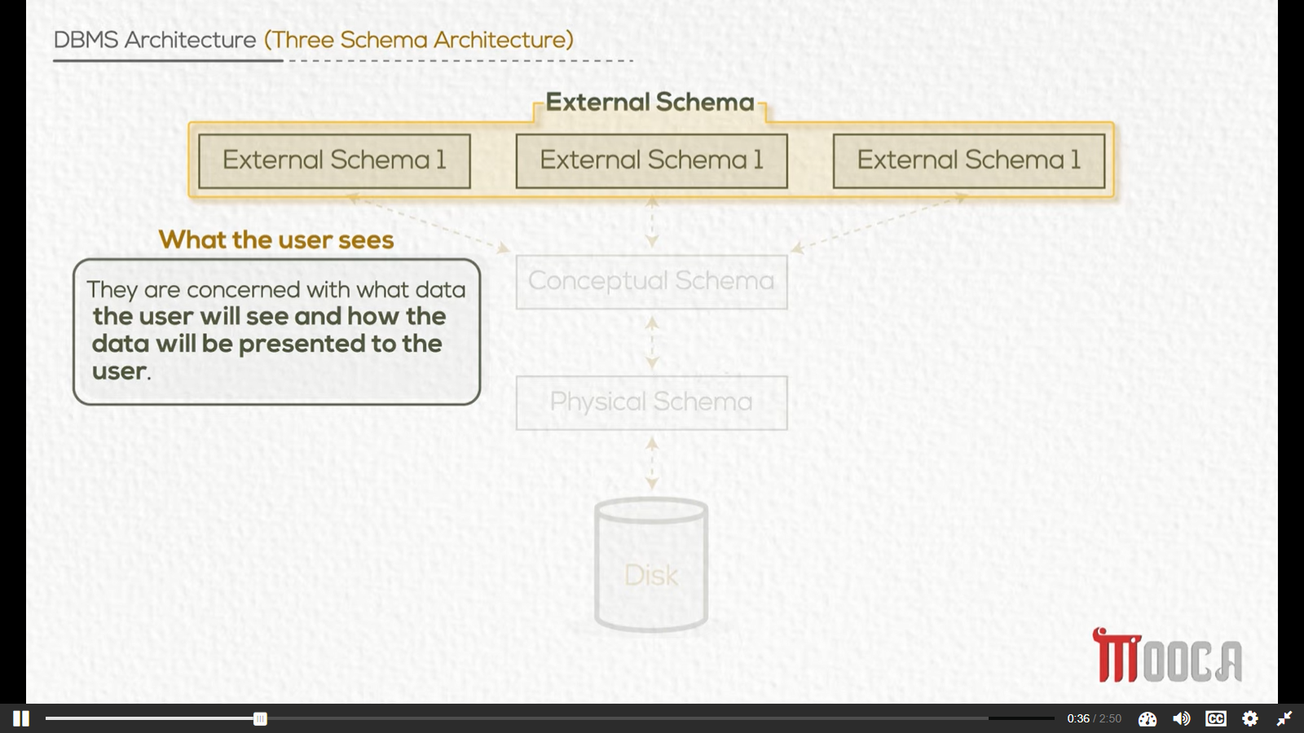

Slide 25
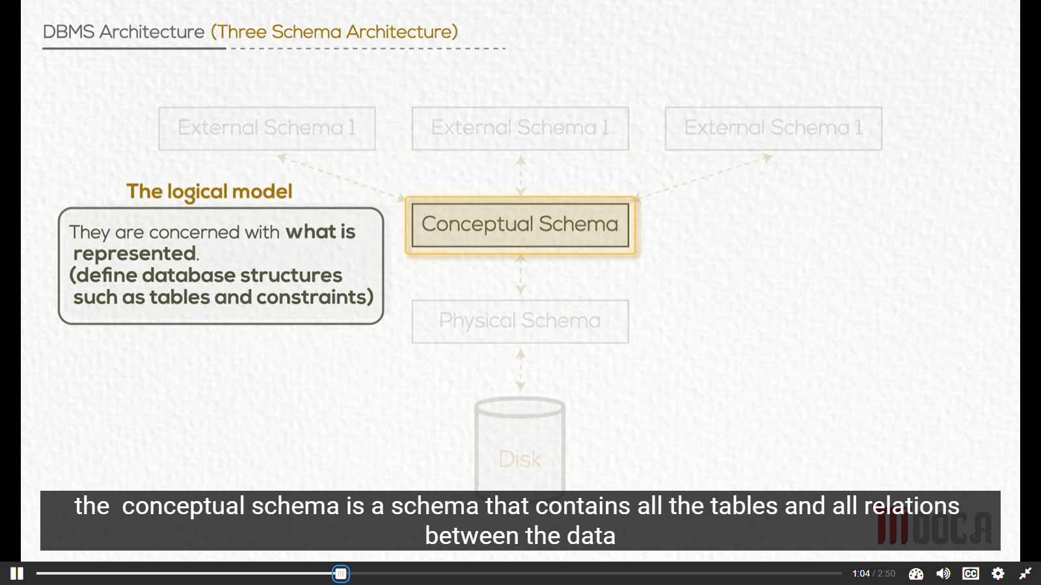

Slide 26
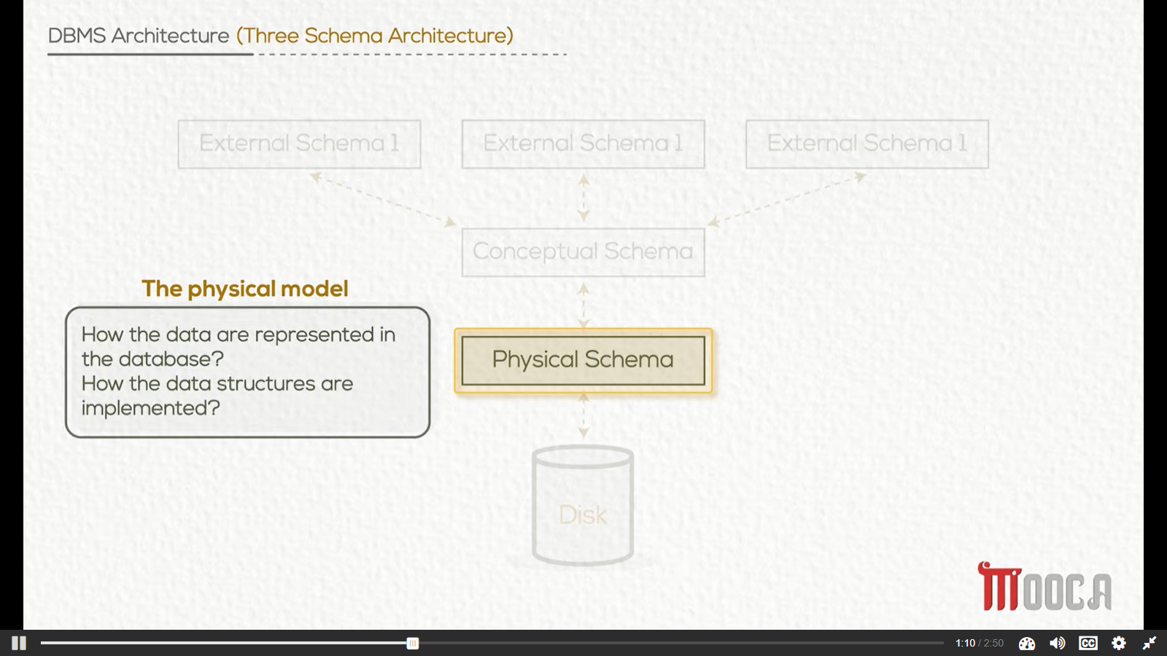

Slide 27
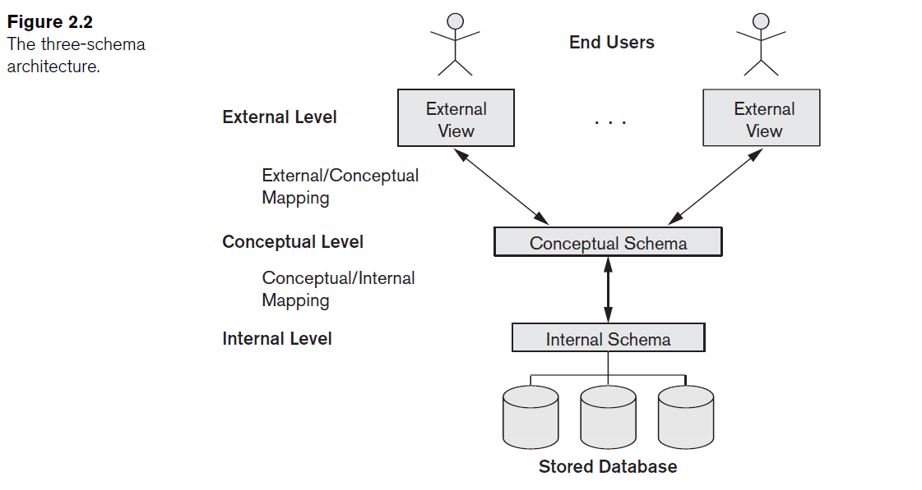

Slide 28
Mapping
It is the processes of transforming requests and results between levels.

Slide 29
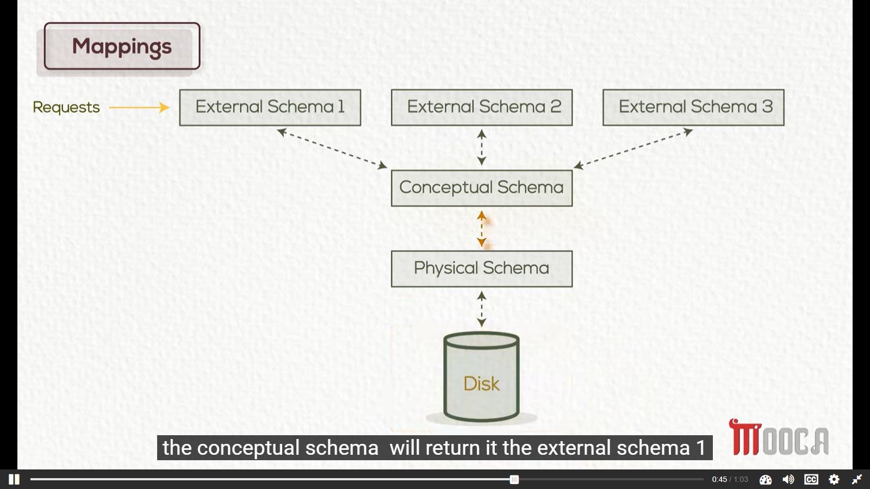

Slide 30
Data Independence
The capacity to change the schema at one level without having to change the schema at the next higher level
Notes:
Two Types of data Independence:
Logical Data Independence
Physical Data Independence: The capacity to change the internal schema without having to change the conceptual schema.

Slide 31
Distributed Processing
DATA: Includes database definition, data integrity logic and all other objects that are associated with the data (The role of the DBMS).
Business: Includes the application logic and business rules.
For example, ensuring that the employee s salary won’t exceed 5000 LE and must be positive and so on.
Presentation: The way of presenting the data to users, that is usually implemented on the client (application program).

Slide 32
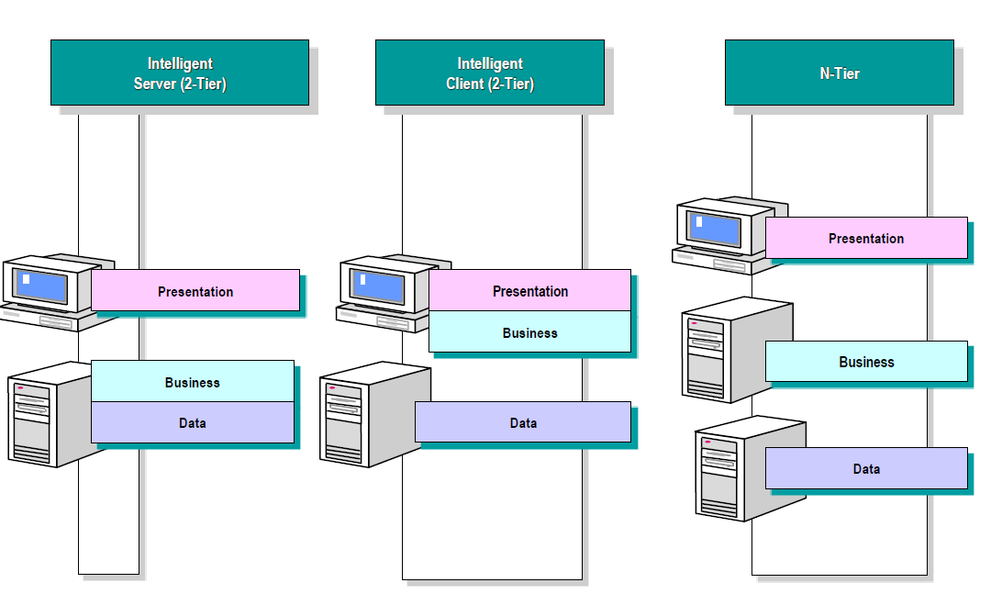
Distributed Processing
DATA: Includes database definition, data integrity logic and all other objects that are associated with the data (The role of the DBMS).
Business: Includes the application logic and business rules.
For example, ensuring that the employee s salary won’t exceed 5000 LE and must be positive and so on.
Presentation: The way of presenting the data to users, that is usually implemented on the client (application program).

Slide 33
Centralized Database Environment
Mainframe environment
Client/Server environment
Internet Computing environment:
Notes:
Mainframe environment: consists mainly of a powerful mainframe that is networked with dumb terminals.
Client/Server environment: involves a main computer, called a server, and one or more personal computers that are networked to the server. The database resides on the server, a separate entity from the personal computer. Each user who requires access to the database on the server should have his/her PC.
Internet Computing environment: the application need only be installed on one server, called a web server. A user must have an internet connection and a supported web browser installed on the PC. The web server, in turn, accesses the database in a fashion supported by the application, and returns the requested information to the user’s web browser.

Slide 34
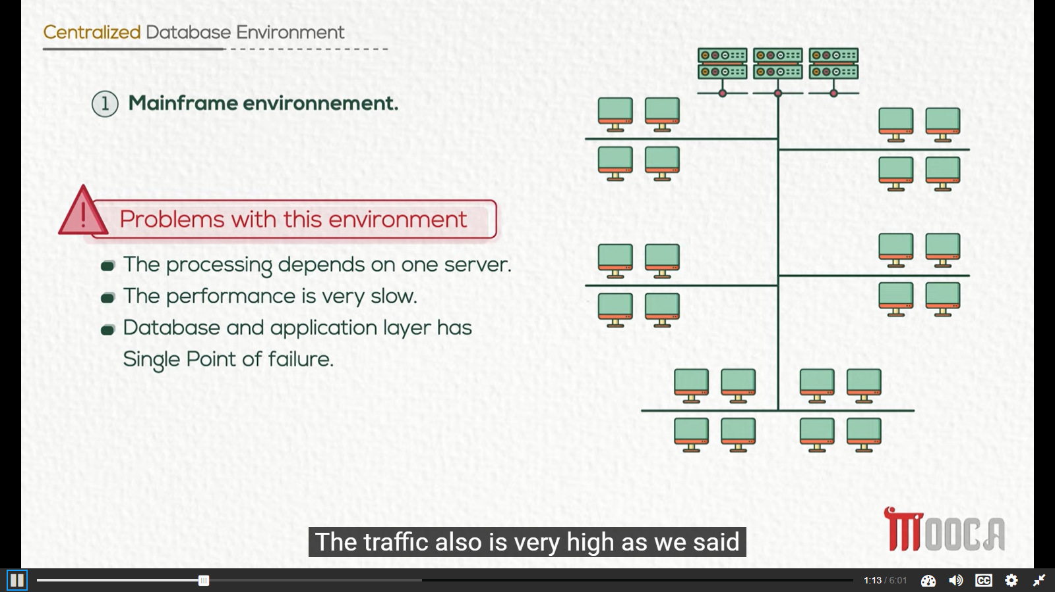
Centralized Database Environment
Notes:
Mainframe environment: consists mainly of a powerful mainframe that is networked with dumb terminals.
Client/Server environment: involves a main computer, called a server, and one or more personal computers that are networked to the server. The database resides on the server, a separate entity from the personal computer. Each user who requires access to the database on the server should have his/her PC.
Internet Computing environment: the application need only be installed on one server, called a web server. A user must have an internet connection and a supported web browser installed on the PC. The web server, in turn, accesses the database in a fashion supported by the application, and returns the requested information to the user’s web browser.

Slide 35
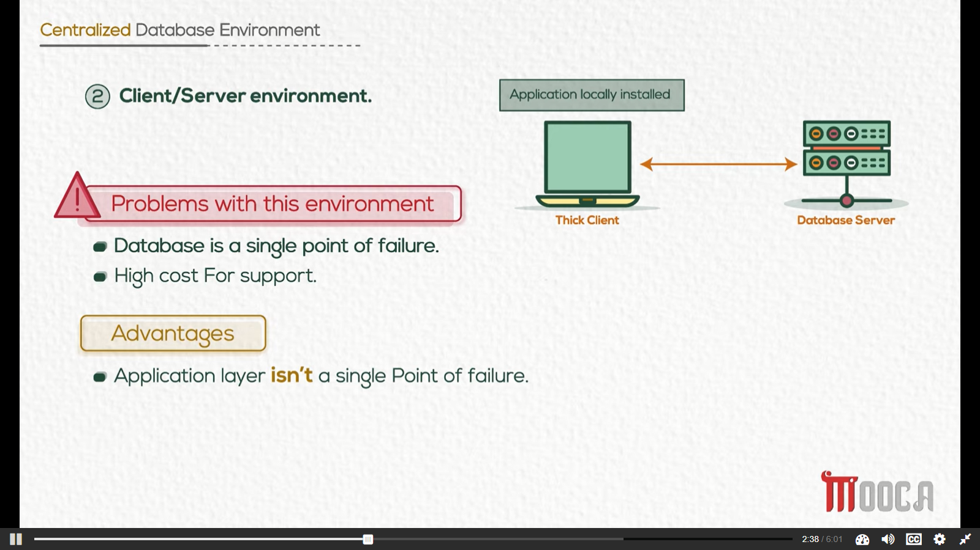
Centralized Database Environment
Notes:
Mainframe environment: consists mainly of a powerful mainframe that is networked with dumb terminals.
Client/Server environment: involves a main computer, called a server, and one or more personal computers that are networked to the server. The database resides on the server, a separate entity from the personal computer. Each user who requires access to the database on the server should have his/her PC.
Internet Computing environment: the application need only be installed on one server, called a web server. A user must have an internet connection and a supported web browser installed on the PC. The web server, in turn, accesses the database in a fashion supported by the application, and returns the requested information to the user’s web browser.

Slide 36
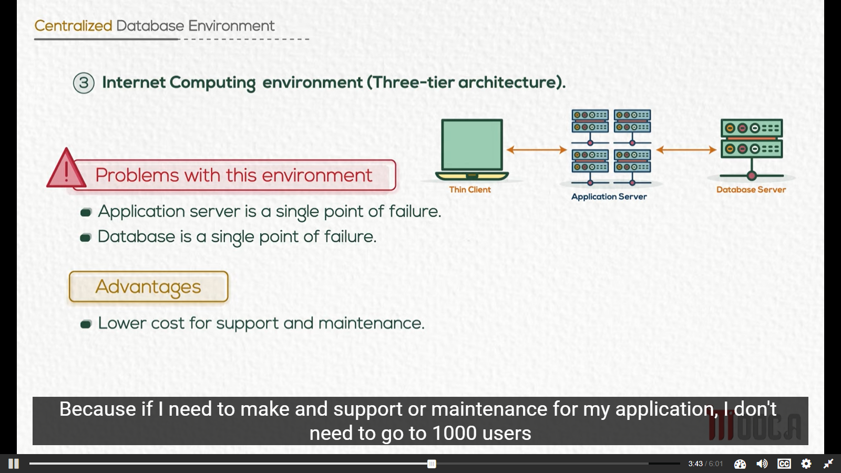
Centralized Database Environment
Notes:
Mainframe environment: consists mainly of a powerful mainframe that is networked with dumb terminals.
Client/Server environment: involves a main computer, called a server, and one or more personal computers that are networked to the server. The database resides on the server, a separate entity from the personal computer. Each user who requires access to the database on the server should have his/her PC.
Internet Computing environment: the application need only be installed on one server, called a web server. A user must have an internet connection and a supported web browser installed on the PC. The web server, in turn, accesses the database in a fashion supported by the application, and returns the requested information to the user’s web browser.

Slide 37
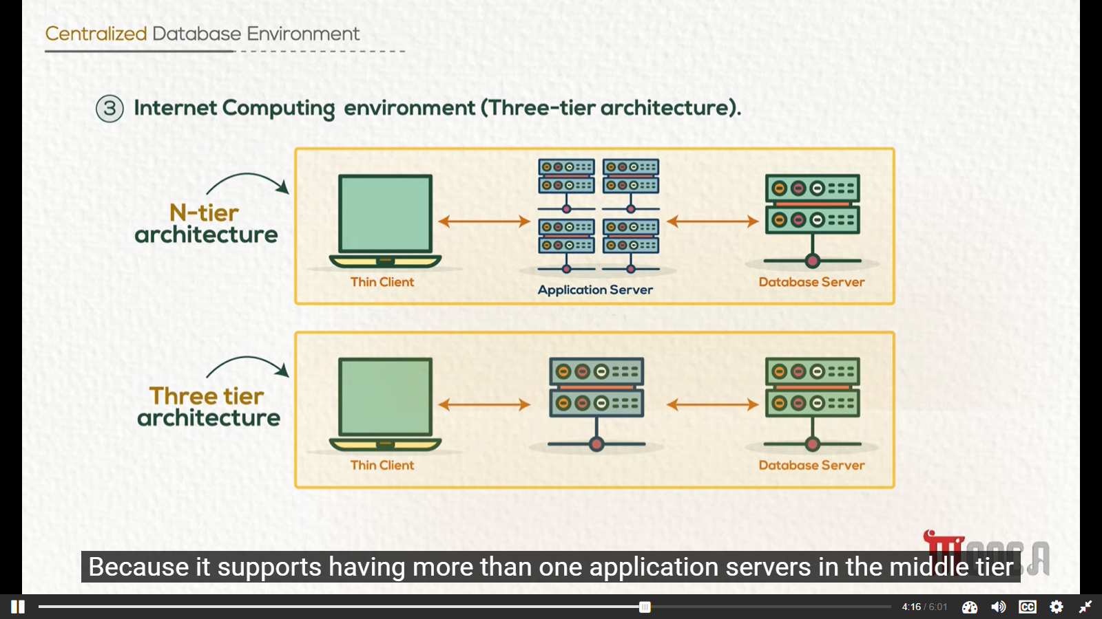
Centralized Database Environment
Notes:
Mainframe environment: consists mainly of a powerful mainframe that is networked with dumb terminals.
Client/Server environment: involves a main computer, called a server, and one or more personal computers that are networked to the server. The database resides on the server, a separate entity from the personal computer. Each user who requires access to the database on the server should have his/her PC.
Internet Computing environment: the application need only be installed on one server, called a web server. A user must have an internet connection and a supported web browser installed on the PC. The web server, in turn, accesses the database in a fashion supported by the application, and returns the requested information to the user’s web browser.

Slide 38
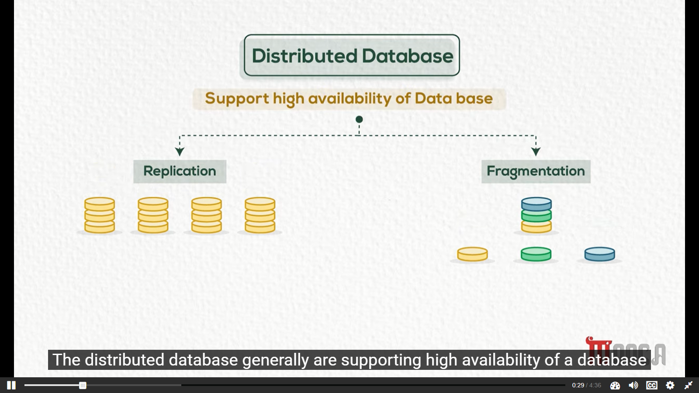
Distributed Database

Slide 39
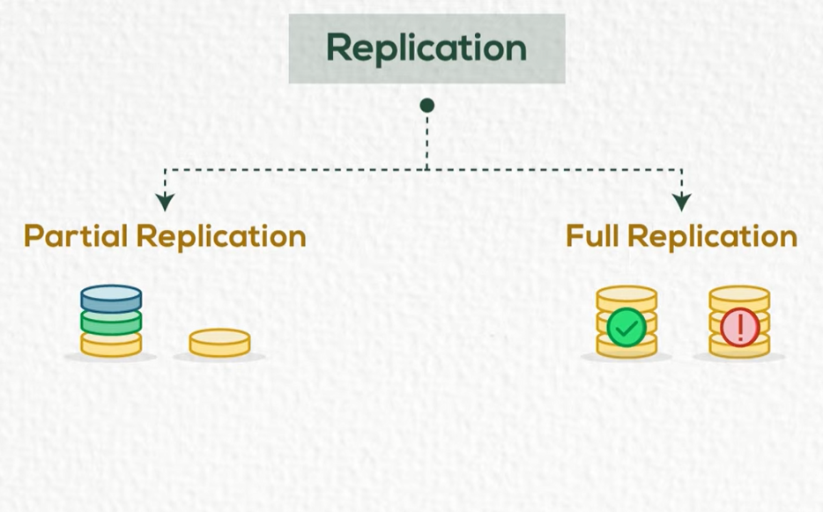
Distributed Database

Slide 40
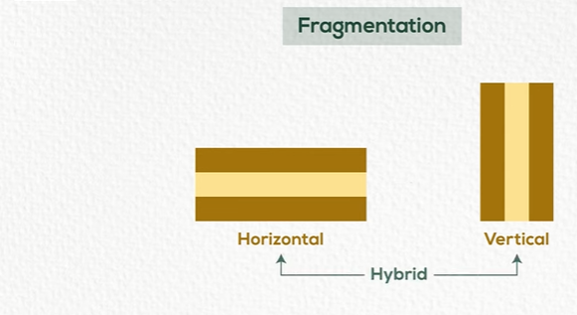
Distributed Database

Slide 41
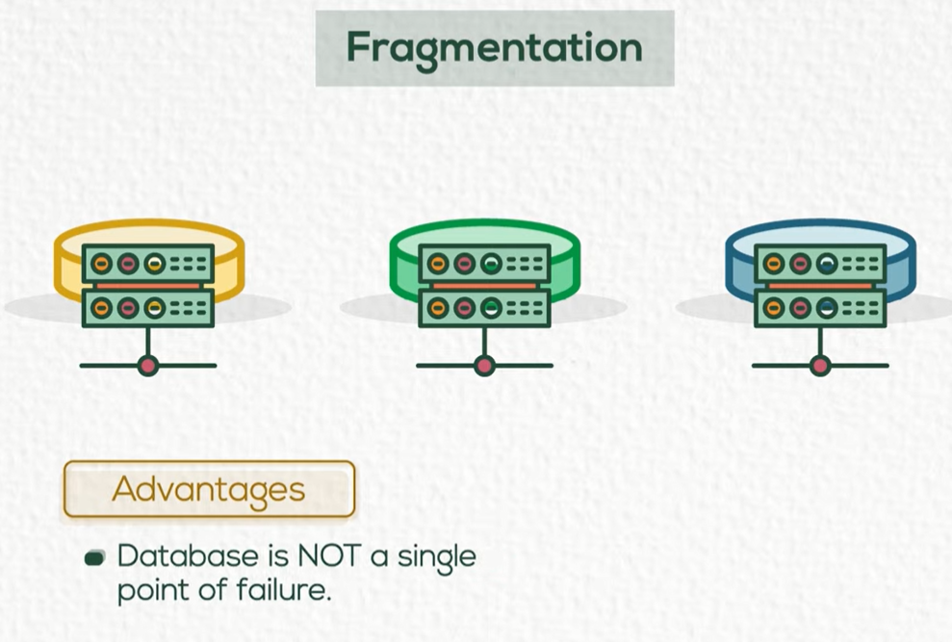
Distributed Database

Slide 42
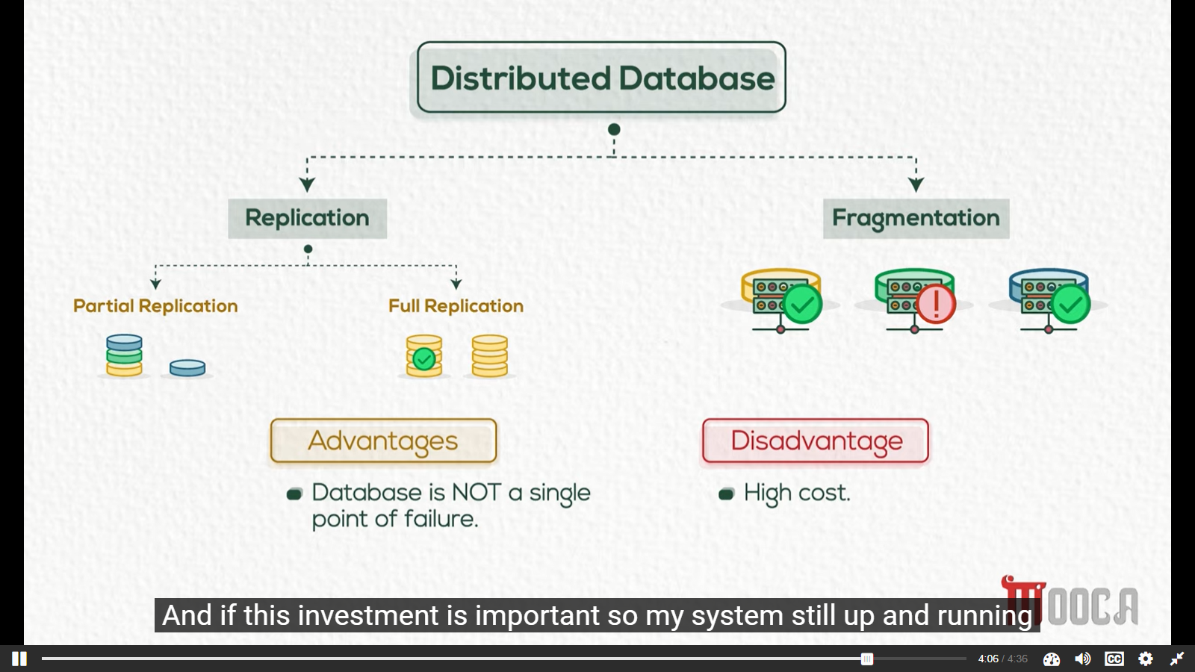
Distributed Database

Slide 43
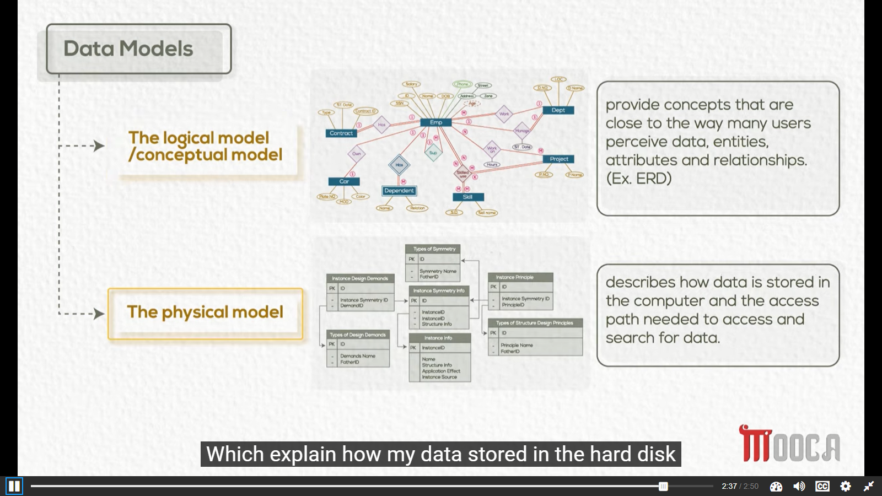

Slide 44
Data Models
High Level or Conceptual data models provide concepts that are close to the way many users perceive data, entities, attributes and relationships. (Ex. ERD)
Physical data models describes how data is stored in the computer and the access path needed to access and search for data.

Slide 45
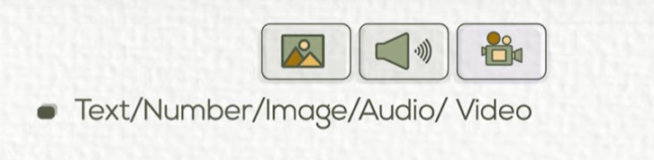
DBMS Other Functions

Slide 46

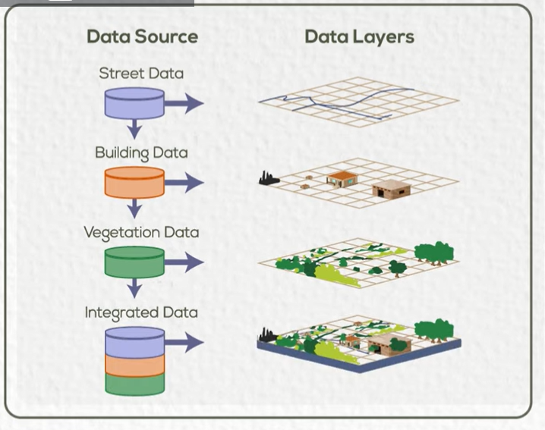
DBMS Other Functions

Slide 47

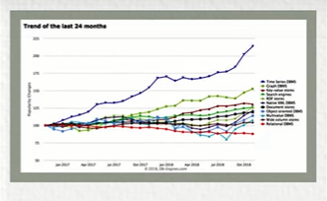
DBMS Other Functions

Slide 48

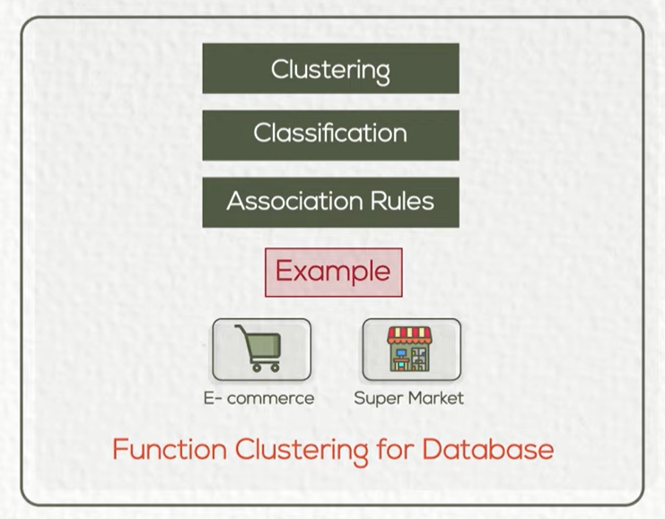
DBMS Other Functions

Slide 49


